Slide 1

Enabling Reproducibility with Docker

Slide 2
Enabling Reproducibility with Docker
Gerardo Hidalgo-Cuellar
RC Homepage: https://www.colorado.edu/rc/
RC Docs: https://curc.readthedocs.io/en/latest/
RC Helpdesk: rc-help@colorado.edu
Course Materials: https://github.com/ResearchComputing/Containers_Spring_2022

Slide 3
Outline
Part 1: Container fundamentals and Docker (4/7/2022)
Reproducibility and the Case for Containers
Containers
Docker
Images and Containers
Commands
File Access
Building Docker Images
DockerHub
Part 2: Containers for HPC w/ Singularity (4/14/2022)

Slide 4
Tutorial Files:
This tutorial will have interactive components
If you would like to participate in the demos provided for this tutorial then first clone the test files from GitHub to your desired location:
Navigate to a desired directory
Clone the repository:
git clone https://github.com/ResearchComputing/Containers_Spring_2022.git
Navigate into the directory and store the path into a variable:
cd Containers_Spring_2022
export CONTAINER_ROOT=$(pwd)

Slide 5
Reproducibility and Research
Scientific Software is often challenging to work with
Difficult installation
Low support from the developers
Very outdated
Complex Dependency trees
Because of this it's often desired for a software to be repeatable and accurate.
But installs are only done once. Why should I care about reproducible applications.

Slide 6
Reproducibility and Research
Research is Collaborative
Team members work together to get projects done.
Reproducibility ensures all members of a team can provide productivity towards a project.
Research is Correcting
Research is hard
Academic reviews are commonplace
Someone may wish to accurately reproduce your work
Research is Continuous
You may be working on a single project for a long period of time
What happens in you move, but bring your work to another system?

Slide 7
Options for reproducibility
Lots of options!
Detailed instructions
Software bundles
Virtual Environments
Python, Anaconda, Spack
But do they really enable accurate reproducibility?
Incorrect installs?
Hardware or OS?
Performance?

Slide 8
Containers
A Container is an isolated environment: packaged bundle of libraries, dependencies, and files that runs as a process under a host OS
Containers use an application on the host operating system called a Container Manager
Manages operating system and libraries run as containers
Similar to virtual machines, but does not need dedicated CPUs memory or storage

Slide 9
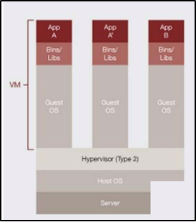
Virtualization (1)
Virtualization is a technology that utilizes software to abstract components of a technology
Common application is Hardware Virtualization
Virtual Machines
Partitions off Memory, CPU, GPU, and Storage
Runs a virtual OS
Runs software on the virtualized machine
Examples: VMware, Virtualbox
Material courtesy: M. Cuma, U. Utah

Slide 10
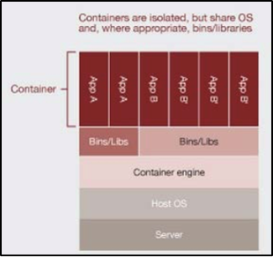
Virtualization (2)
Another use of virtualization is in OS Level Virtualization
Can run many isolated guest OS instances under a host OS kernel
This virtualization is what is used by Docker and other container software.
Virtualizing software, not hardware
Share a kernel
Best of both worlds!
Isolated environments
No hardware partitioning
Material courtesy: M. Cuma, U. Utah

Slide 11




Containerization Software
Docker
Well established – largest user base
Has Docker Hub for container sharing
Problematic with HPC (Fix incoming!)
Singularity
Designed for HPC
Second largest user base
Developed for scientific use
Charliecloud; Shifter
Designed for HPC
Based on Docker
Less user-friendly

Slide 12
Installing Docker
Docker Desktop
Comfy GUI to help keep track of containers and images!
Available on all operating systems (beta on Linux)
Windows users can enable WSL2 support following the instructions here: https://docs.docker.com/docker-for-windows/install/
Docker hosted lab environment (Need Docker account, limited availability)
https://labs.play-with-docker.com/
Docker toolbox
Legacy solution for Windows and Mac for versions that do not meet the version requirements.
Utilizes the Virtual Box hypervisor for virtualization

Slide 13
Docker: 3 main components
Docker File
Like DNA, code that tells docker how to build an image
Image
Snapshot of your software along with all of its dependencies (down to OS level)
Immutable (mostly) and can be used to spin up multiple containers
Container
Running instances of images that are isolated and have their own sets of environments and processes
Actual software running in the real world

Slide 14
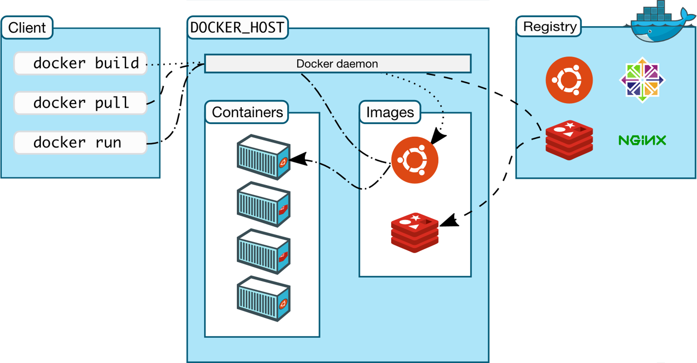
Docker Nuts and Bolts
Docker runs on a concept of images and containers.
Images: Saved snapshots of a container environment.
Made from a Dockerfile or pulled from Docker Hub
Stored in the Docker cache on your disk
Immutable (mostly…)
Containers: Instances of images that are generated by Docker when an image is 'run'
Instance of image running in memory
Ephemeral and state cannot be saved
Can be run interactively

Slide 15
Docker ‘Hello World’
Let's start with something simple:
Docker "Hello, World!"
Relatively small image
No dependencies
Built as a general test case
Command we will run:
docker run hello-world

Slide 16
Docker Commands
Docker Commands are usually in the form of:
docker <sub-command> <flags> <target/command>
Examples:
docker run -it myimage
docker container ls
docker image prune

Slide 17
Launching a Docker Container
Launch docker image as a container:
docker run <image-name>
Run a docker image interactively:
docker run -it <image-name>
If an image is not on the system, then Docker will search DockerHub to see if the image exists, and pull it down locally
Specify commands after your image to execute specific software in your container.
docker run <image-name> <program>
Example:
docker run -it ubuntu bash

Slide 18
Listing Containers
When a container is run it is assigned a name, an ID, name of the image used to run the container, current status.
List all currently running containers
docker ps
List all containers
docker ps -a

Slide 19
Stopping/Removing a container
You can stop a container using the “stop” command:
docker stop <name or ID>
If you don’t know the docker name or id you can list containers
If you don’t want a stopped container taking up space you can remove it with the remove command:
docker rm <name or ID>
docker container rm <name or ID>

Slide 20
Images
To see a list of images (templates) for our container:
docker images
docker image ls
To remove an image:
docker rmi <name>
docker image rm <name>
To download an image but not run an image:
docker pull <name>

Slide 21
Exploring a Docker Container
Docker containers are running tiny operating systems!
We can explore the operating system by invoking a shell
docker run -it ubuntu bash
This command launches the ubuntu Docker container with the command ‘bash’
We can also run a command on an already running container with the “docker exec” command:
docker run -d ubuntu sleep 100
docker exec <container-id> cat /etc/*release*

Slide 22
Demo 1: Running a Container

Slide 23
Demo 1: GROMACS
GROMACS is a molecular dynamics application that can often be a complex and challenging installation for the average user. Linux and Mac only
Dense Documentation
Software requires compilation
Luckily, this can be trivialized with Docker!
Run the command:
docker run gromacs/gromacs gmx help commands
docker run -it gromacs/gromacs

Slide 24
Demo 1: GROMACS
An example using pdb2gmx from the tutorial KALP15 in DPPC:
$ mkdir $HOME/data ; cd $HOME/data
$ wget http://www.mdtutorials.com/gmx/membrane_protein/Files/KALP-15_princ.pdb
$ docker run -v $HOME/data:/data -w /data -it gromacs/gromacs gmx pdb2gmx -f KALP-15_princ.pdb -o KALP-15_processed.gro -ignh -ter -water spc
When prompted, choose the GROMOS96 53A6 parameter set (13) and choose "None" for the termini

Slide 25
Docker Image/Container Commands
Container Commands​ | ​
docker container ls ​ | List docker containers currently running:​
docker container rm <container>​ docker rm <container> ​ | Remove (an) container(s):​
docker container prune​ | Remove all stopped containers​
Image Commands​ | ​
docker image ls ​ | List docker images stored in cache:​
docker image rm <image>​ docker rmi <image> ​ | Remove (an) image(s):​
docker image prune​ | Remove unused images​

Slide 26
Docker Image/Container Commands
Commands​ | ​
docker info​ | Shows Docker system-wide information​
docker inspect <docker-object>​ | Shows low-level information about an object​
docker config <sub-command>​ | Manage docker configurations​
docker stats <container>​ | Shows container resource usage​
docker top <container>​ | Shows running processes of a container​
docker version​ | Shows docker version information​
More details and commands can be found on the docker documentation page

Slide 27
DockerHub
The place where containers live! I.e. Image Registry
Dockerhub is a Docker hosted library of public and private Docker images, with an account:
Free and unlimited public images
1 free private repository
Great for hosting images for fellow researchers
“Git-like” commands

Slide 28
Building a Docker Container
To build a docker container, we need a set of instructions Docker can use to set up the environment.
Dockerfile (<- must have this name, no extensions)
Once we set up our Dockerfile we can use the command
docker build –t <image-name> .
Then we can run the image with our docker run command
docker run <image-name>

Slide 29
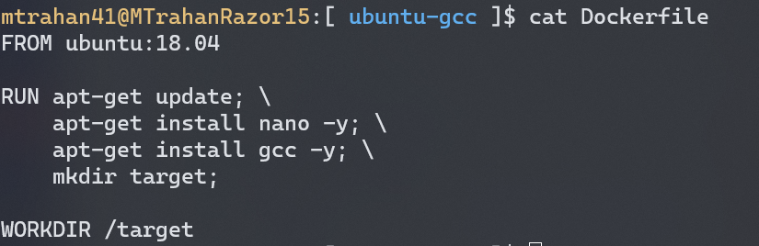
What's in a Dockerfile
A Dockerfile is simply a text file that contains instructions to build and setup a default Image
Commands to build
Setting commands
Requires a source Image
a “template” image

Slide 30
What's in a Dockerfile
FROM
start FROM a “template” image
base image gets pulled down from cloud
RUN
to RUN terminal commands
install dependencies
WORKDIR, ENV, etc…
CMD
execute a default CMD

Slide 31
Demo 2: Building a Docker Image

Slide 32
Demo 2: Ubuntu w/ GCC
For this first example we will build a custom Ubuntu image that will provide a location to run the GNU Compiler Collection.
Dockerfile provided:
Need to build:
Navigate to the directory:
cd $CONTAINER_ROOT/dockerdemo/ubuntu-gcc
Build the image with:
docker build -t test-gcc .
Run image as container:
docker run -it test-gcc

Slide 33
Demo 2: Ubuntu w/ GCC
What happens if we create a file in the container?
Does it persist if we exit?
No! Containers are ephemeral and run in host memory
How can we persist data?

Slide 34
Mounting and File Access (1)
So now that we have a working container, how can we access the test files we downloaded?
Mounting directories: Bind Mount
Allows the docker container to access files on the host OS
Choose host's source directory, files in the directory will be moved to the container's target directory
Source Directory: Directory on the host system. Never within a container.
Target Directory: Directory in the Docker Container. Never on the host system.
A flag set within the docker run command:
docker run -v <source-dir>:<target-dir> <image>

Slide 35
Mounting and File Access (2)
Mounting directories: Volume Mount
Same concept, but volumes are stored within docker cache.
Create Docker volumes in your terminal and link your volume directory
Similarly linked through the docker run command.
docker run -v <volume-name>:<target-dir> <image>

Slide 36
Demo 2 (Cont.): Mounting
Returning to our demo, can we give our container access to our test files?
Let's use a bind mount!
In the directory where our Dockerfile lives, use this command (all on one line):
docker run -it -v $(pwd)/source:/target test-gcc
Command:
gcc hello.c -o hello.exe
./hello.exe

Slide 37
Modifying a Docker Image
Suppose you have an existing docker image and want to make changes…
Rebuild Dockerfile!
Usually a bit cumbersome
No Dockerfile? Use docker commit!
First you can run an image interactively and install what you need:
$ docker run -it <image-name> bash # or any shell…
$ apt-get update
$ apt-get install vim
Exit, then commit it to a new image
$ docker commit <container-id> <new-image-name>

Slide 38
Dockerhub Commands
Download and upload docker images with ease.
docker run <image>
docker pull <image>
Uploading a little more complicated...
Sign in with:
docker login
List docker images with:
docker image ls
Tag your image:
docker tag <image-id> <your-username>/<image-name>:<tag>
Push!
docker push <your-username>/<image-name>

Slide 39
Demo 3: NCL container

Slide 40
Demo 3: NCL Container
For this next example we will be building a Docker image that will run the NCAR Command Language (NCL)
Dockerfile provided
Same process:
Navigate to the Dockerfile found at:
$ CONTAINER_ROOT/dockerdemo/ncl
Build the Dockerfile and name the image: "ncl-demo"
Run "ncl-demo"
Can we test a sample script?
$ docker run -v $(pwd)/source:/target ncl-demo ncl test.ncl

Slide 41
Docker Compose
External Utility that can create and install docker images.
Builds docker images based on a docker-compose.yml file.
YAML: YAML Ain't Markup Language
Data serialization language
Describes containers you wish to build with what features.
Not a docker command but comes bundled with Docker Desktop!

Slide 42
Docker Compose Commands
Build all containers in YAML file
$ docker-compose build
Build and run all containers in YAML file:
$ docker-compose up
List all containers in YAML file:
$ docker-compose images
Run a one-off command from a container:
$ docker-compose run <container-name> <command>
Example (after build):
$ docker-compose up

Slide 43
Demo 4: Docker Compose (python)

Slide 44
Questions?

Slide 45
Additional Resources
Docker: https://www.docker.com/
Docker Docs: https://docs.docker.com/
Docker Hub: https://hub.docker.com/

Slide 46
Thank you!
Please fill out the survey: http://tinyurl.com/curc-survey18
Contact information: rc-help@Colorado.edu
Slides: https://github.com/ResearchComputing/Containers_Spring_2022

